Slide 1
Autoencoder and U-net
Neural Networks
Wei Dai
wei.dai@uq.edu.au

Slide 2
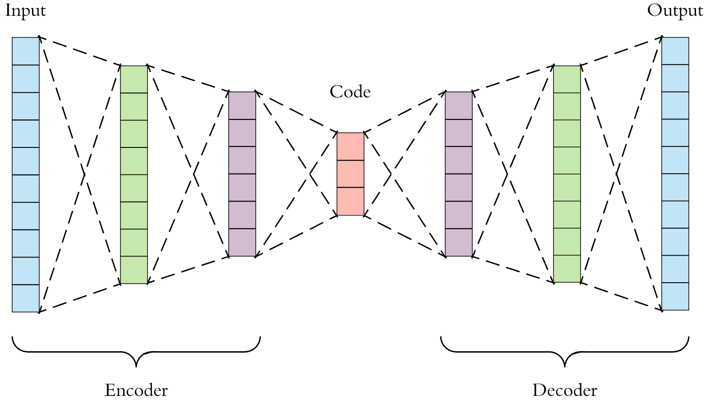
Autoencoder
Structure:
Encoder
Latent Space
Decoder
Distance function (“loss”)
Characteristics:
Data-specific
Lossy
Automatic learning
Inverse Operation
#deep-learning-uq
Notes:
Encoder: take the feature data and encodes it to fit into the latent space
Latent space represent some key features from input images
Decoder: take the encoded data and convert it back to the full size feature data
Loss: The amount of information loss between compressed representation of your data and decompressed representation
Key: 1. what models learn is how to encode the data efficiently so the decoder can convert it back to the original.
2. the essential part is to generate a optimized latent space

Slide 3
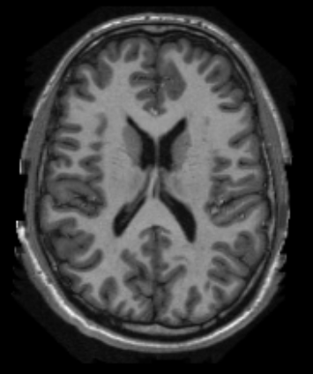
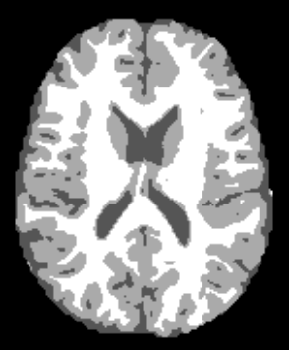
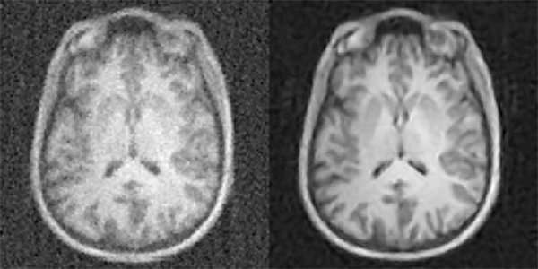
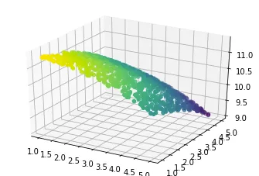
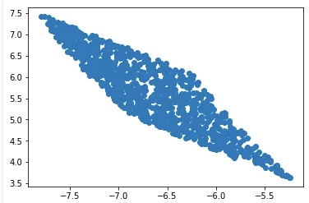
Usage of Autoencoder
https://theffork.com/activation-functions-in-neural-networks/
Image segmentation
Reconstruction/Denoise:
Dimensionality Reduction for visualization
https://theailearner.com/2019/01/21/dimensionality-reduction-for-data-visualization-using-autoencoders/
#deep-learning-uq

Slide 4
Network Training process
https://theffork.com/activation-functions-in-neural-networks/
Stage 1: Data preparation
Data Loading
Data Pre-processing
Stage 2: Training Stage
Building the model
Compile the model
Train the model
Model evaluation
Model Prediction
Stage 3: Testing Stage
Performance Evaluation
Stage 4: Evaluation
#deep-learning-uq

Slide 5
Data preparation: Data loading
Traditional method (fully customizable):
Load the all filenames into list
Load each data into np.array using its filename
Combine all data array into single array or using iterative (generator)
os.listdir()
glob.glob()
From pillow import Image
Image = Image.open(“filename”)
Tensorflow built-in methods:
Built-in data library (easy, no customize)
Only has common datasets
E.g. tf.keras.datasets.mnist.load_data()
tf.keras.preprocessing.image_dataset_from_directory() (medium, limited customize)
only works for tf_version = 2.3.0
limited image formats: jpeg, png, bmp, gif
tf.data.Dataset: (hard, fully customize)
Dataset = tf.data.Dataset.list_files(“filename_pattern”)
Dataset.map(lambda_function_for_image_reading)
#deep-learning-uq
Notes:
Tf.data.dataset is a API which used to create a source dataset from your input data

Slide 6
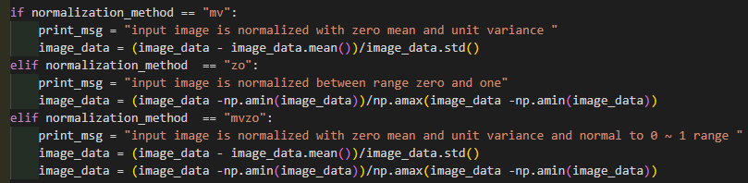
Data preparation: Data pre-processing
Why do we need pre-processing?
messy and from different sources
Standardize and clean up
Reduce complexity and increase performance
Techniques:
Reduce complexity
Convert to grey scale
Standardize images
Clip
Crop
Normalization
Change data structure for specific task
One-hot encoding
Training set
Overall Dataset
Validation set
Testing set
#deep-learning-uq

Slide 7
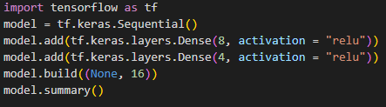
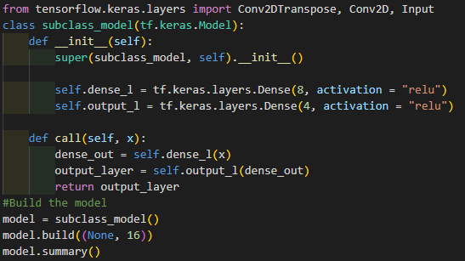
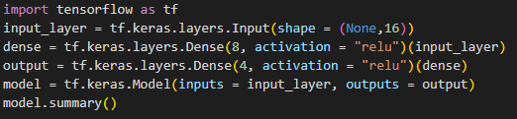
Training Stage: Build the model
Head
Body 1
Body 2
Tail
Building method:
Sequential Method (easy):
…….
Model Subclassing(hard):
Functional API (medium):
#deep-learning-uq

Slide 8
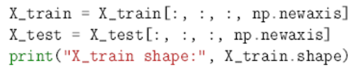
Training Stage: Build the model
Common Layers:
Input layer:
SHAPE is important
Let’s say we have a input set with shape of (Number of images, h, w)
The input needs to be a 4D tensor when using 2D operation (CONV2D) or 5D tensor when using 3D operation (CONV3D)
tf.keras.Input(shape = (h, w, channel_number))
Correspond to number of images:
How many images will be fed at same time during training
(None, h, w, channel_number)
Output Image
Output Image
Output Image
Input Image
Input Image
Output Image
Filter
Output Image
Filter
Output Image
Filter
=
CONV2D
Filter
Filter
Filter
(32,32)
(32,32,1)
(3,3,32)
(32,32,32)
#deep-learning-uq

Slide 9
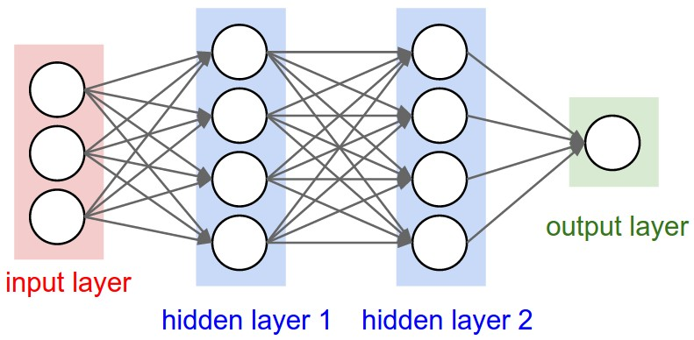
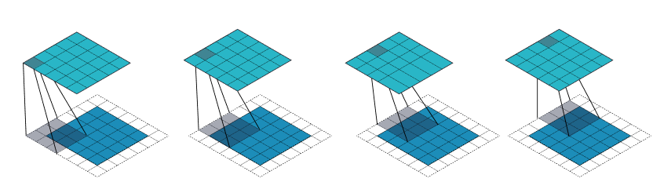
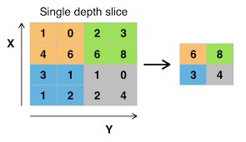
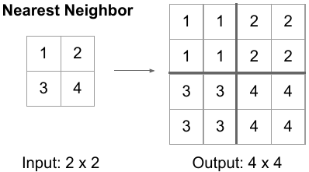
Training Stage: Build the model
Common Layers:
Hidden layers
Connecting layers:
Dense Layer
tf.keras.layers.Dense(units, activation, kernel_initialize, activity_regularizer, …)
Convolution Layer
tf.keras.layers.Conv2D(filters, kernel_size, strides, padding, activation, kernel_initialize, activity_regularizer, …)
Sampling layers:
Pooling layer (down-sampling)
tf.keras.layers.MaxPool2D(pool_size, strides, padding)
Up-sampling layer
tf.keras.layers.UpSampling2D(size, interpolation)
#deep-learning-uq

Slide 10
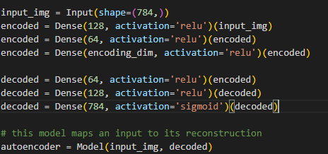
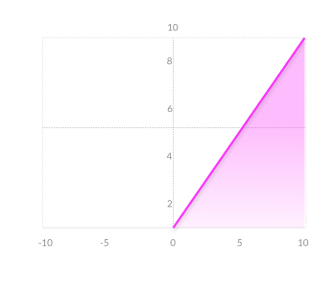
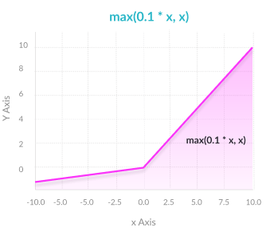
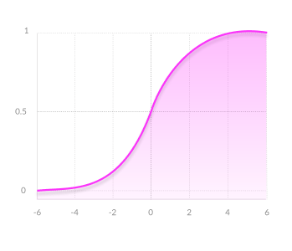
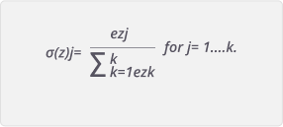
Training Stage: Build the model
Activation:
Hidden layer activation
Output layer activation
ReLU
Leaky ReLU
Sigmoid:
Prediction: [0.8], [0.2], [0.6]
Ground truth: [1 ] ,[0 ], [0 ]
SoftMax:
Prediction: [0.7, 0.2, 0.1]
Ground truth: [1 , 0 , 0 ]
Prediction: [0.1, 0.8, 0.1]
Ground truth: [0 , 0 , 1 ]
Sigmoid
SoftMax
#deep-learning-uq
Notes:
Relu:
Pro
Allow faster convergence
Has a derivative function and allows for backgrogation
Con:
1. vanishing gradient for zero and negative value) -> not propagation
Leaky Relu
Small positive slop in negative region
Sigmoid:
Pro:
Cap values between 0 ~ 1 and prevent large output (normalization)
Prevent huge change in gradient
Con:
For large or small value, no changes in value -> vanishing gradient -> model refuse learning or slow learning
Softmax
Able to have multiple classes
normalize the output for each class between 0 and 1 and dvides their sum
Giving the probability of the input value being in a specific
Difference between sigmoid and soft max:
Sigmoid is applied independently to each element of output
Softmax is a function not a loss. It normalize all elements in output in range 0~1 and all elements sum to 1. so basically the results after softmax can be interpreted as class probabilities which each elements represents the probability of that pixel belongs to certain class
https://missinglink.ai/guides/neural-network-concepts/7-types-neural-network-activation-functions-right/

Slide 11
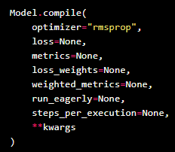
Training Stage: Compile the model
Optimizer:
Gradient Descent:
Depends on first order derivative of a loss function
Calculates which way the weights should alter to reach minima
Stochastic Gradient Descent (“SGD”)
A variant of Gradient Descent, which update parameters more frequently
Momentum:
Gradient Descent with momentum term
Reducing high variance in SGD and softens the convergence
Root Mean Square Propagation(“rmsprop”)
Gradient descent with momentum
Weights updating in vertical direction is restricted, so we could increase learning rate and the algorithm could take larger step
Adaptive Moment Estimation (“Adam”):
works with momentums of first and second order
#deep-learning-uq
Notes:
Optimizer are algorithm or methods which used to change the attributes of your neural network such as weights and learning rate in order to reduce the losses
Gradient Descent:
1. Most basic optimizer
Advantages:
Easy computation.
Easy to implement.
Easy to understand.
Disadvantages:
May trap at local minima.
Weights are changed after calculating gradient on the whole dataset. So, if the dataset is too large than this may take years to converge to the minima.
Requires large memory to calculate gradient on the whole dataset.
SGD:
Advantages:
Frequent updates of model parameters hence, converges in less time.
Requires less memory as no need to store values of loss functions.
Disadvantages:
High variance in model parameters.
May shoot even after achieving global minima.
Momentum:
1. accelerates the convergence towards the relevant direction and reduces the fluctuation to the irrelevant direction
Advantages:
Reduces the oscillations and high variance of the parameters.
Converges faster than gradient descent.
Disadvantages:
One more hyper-parameter is added which needs to be selected manually and accurately.
Adam
we don’t want to roll so fast just because we can jump over the minimum, we want to decrease the velocity a little bit for a careful search
Advantages:
The method is too fast and converges rapidly.
Rectifies vanishing learning rate, high variance.
Disadvantages:
Computationally costly.

Slide 12
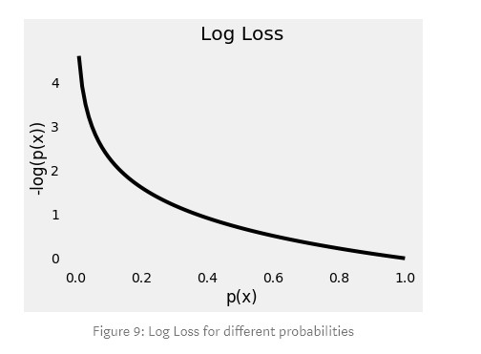

Training Stage: Compile the model
Loss:
Mean squared error (“mse”)
Evaluate the similarity between input and output
$L_{mse}=E{\left|\left|G\left(x\right)−y\right|\right|}^{2}$
CrossEntropy”:
$CE=−\sum_{i}^{C}{t_{i}log⁡(s_{i})}$
Binary CrossEntropy (“binary_crossentropy”)
Binary classes
Sigmoid + crossentropy
$CE=−\sum_{i=1}^{C=2}{t_{i}\log\left(s_{i}\right)}=−t_{1}\log\left(s_{1}\right)−\left(1−t_{1}\right)\log\left(1−s_{1}\right)$
Categorical CrossEntropy (“categorical_crossentropy”)
Multiple classes
Softmax + crossentropy
$CE=−\sum_{i}^{C}{t_{i}log⁡(f{\left(s\right)}_{i})}$ , $f{\left(s\right)}_{i}=\frac{e^{s_{i}}}{\sum_{i}^{c}{e^{s_{j}}}}$
Special case for one-hot encoding
$t_{i}=1$ only for positive class, other classes will be zero
#deep-learning-uq

Slide 13
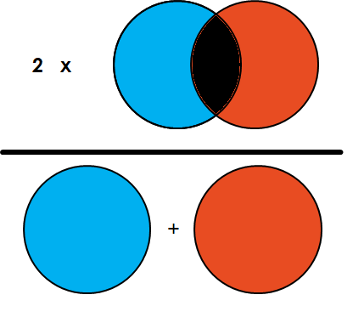
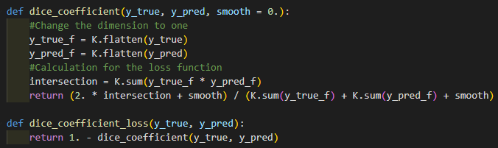
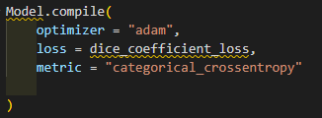

Training Stage: Compile the model
Loss:
Dice similarity coefficient (custom loss)
It gauges the similarity of segmented and manual delineated images based on their overlap measurement
$S_{DSC}=\frac{2\sum_{i∈I}{P_{i}Q_{i}}}{\sum_{i∈I}{P_{i}+\sum_{i∈I}{Q_{i}}} }$
#deep-learning-uq

Slide 14
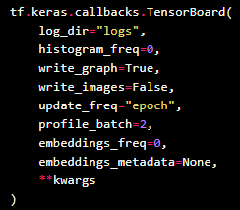
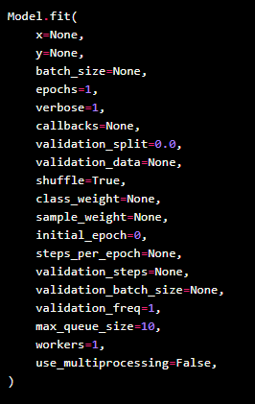
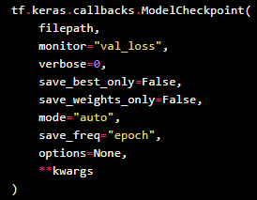
Training Stage: Train the model
Tensorboard
Model.fit()
Model Training:
Model.fit() (easy, not customizable)
Batch_size
Epochs
Validation_split
Callbacks
Actions which can be performed at various stages of training
ModelCheckpoint
Tensorboard
tf.GradientTape() (hard, fully customizable)
ModelCheckpoint
#deep-learning-uq

Slide 15
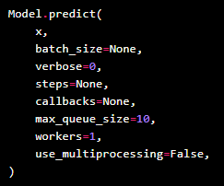
Testing Stage: Model prediction
#deep-learning-uq

Slide 16
Evaluation Stage: Performance Evaluation
Common Evaluation process:
Check the output results visually
plt.imshow()
Check the training plot
Use tensorboard
tensorboard --logdir=“tensorboard_path”
Perform evaluation using metric
Calculate the “accuracy” between predicted label image and ground truth label image
Metrics:
DSC
Surface distance
MSE
#deep-learning-uq

Slide 17
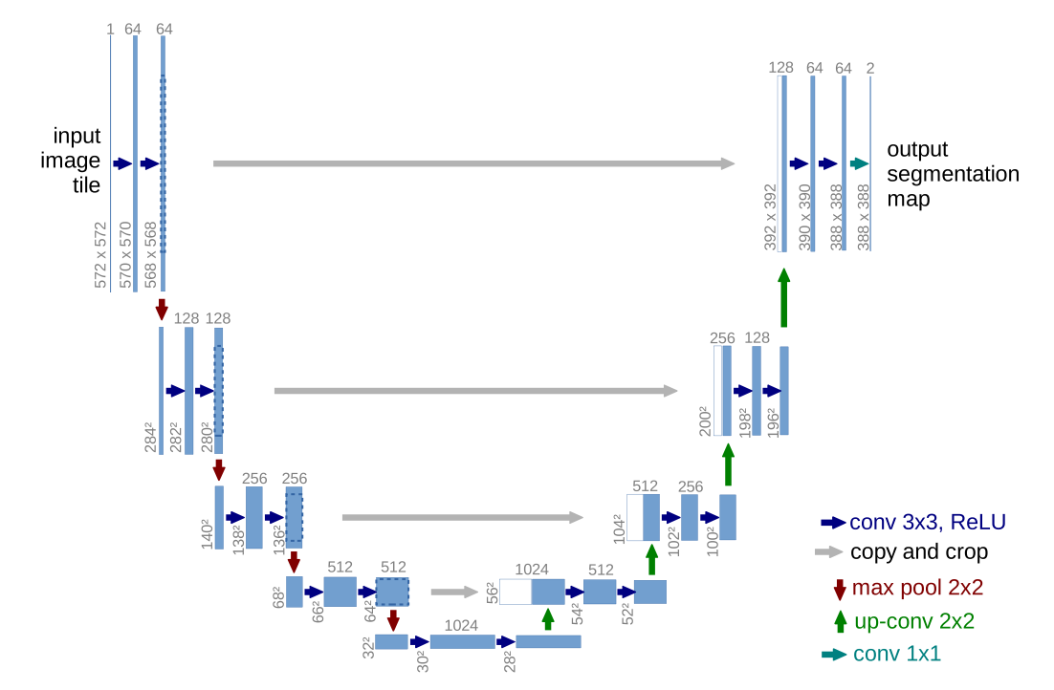
Unet
Encoder-Decoder Structure
Contracting path
Convolution layer
Max-pooling layer
Expanding path
Convolution layer
Up-sampling or Deconvolution layer
Skip connection (long connection)
Concatenation layer
#deep-learning-uq

Slide 18
Thank you

Slide 19
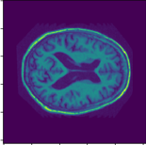

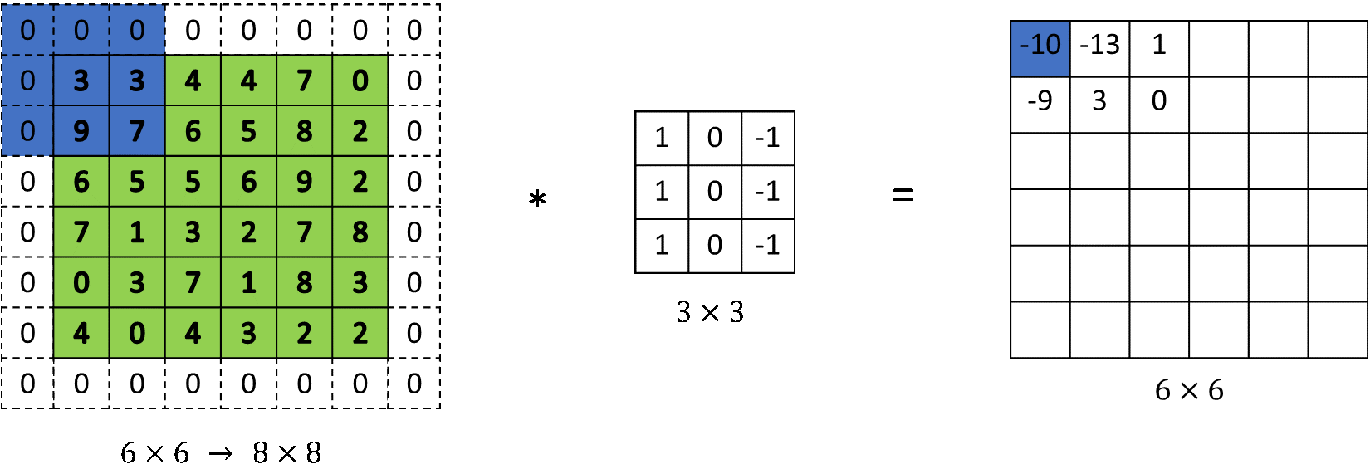
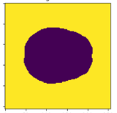

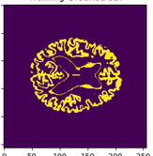


Training Stage: Build the model
Padding:
Padding = “valid”
Padding = “same”
Output Layer:
Classification:
Segmentation:
Label: [1,2,3] ->one-hot
Label[1] = [1,0,0]
Label[2] = [0,1,0]
Label[3] = [0,0,1]
#deep-learning-uq
Notes:
http://datahacker.rs/what-is-padding-cnn/

